Slide 2
Embedded Systems IAY0330 Project: Fishfeeder
Kätlin Lahtvee, Aivar Koodi
Sander Sinijärv, Martin Grosberg
Marek Aare

Slide 3
Objective
Autonomous aquarium
Temperature
Light
Feeding system
Feed level
Filter cleaning reminder
Water level

Slide 4
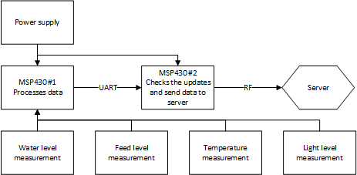
System Architecture

Slide 5
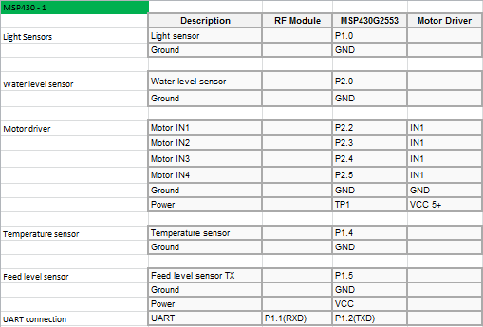
Wiring overview for sensor MSP430

Slide 6
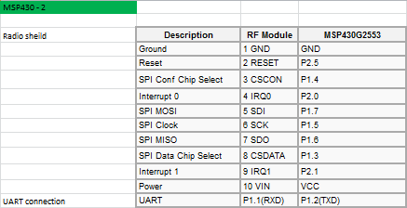
Wiring overview for communication MSP430

Slide 7
Data to server
Data to send to server
Light sensor data
Temperature sensor data
Water level sensor data
Feed level sensor data
Filter cleaning necessity

Slide 8
Component description
2 x TI MSP 430 launchpad
868MHz wireless connection shield
Light sensor
Feeding system (Auger)
Feed level sensors
Stepper motor + driver
Temperature sensor
Water level sensor

Slide 9
Assignements finished
Light sensor is functional
Temperature sensor is functional
Water level sensor is functional
Feed level sensor is functional
Cleaning filter reminder is functional
UART connection between MSP430 boards established
RF connection between fishfeeder and server establised
Fishfeeder auger and casing built

Slide 10
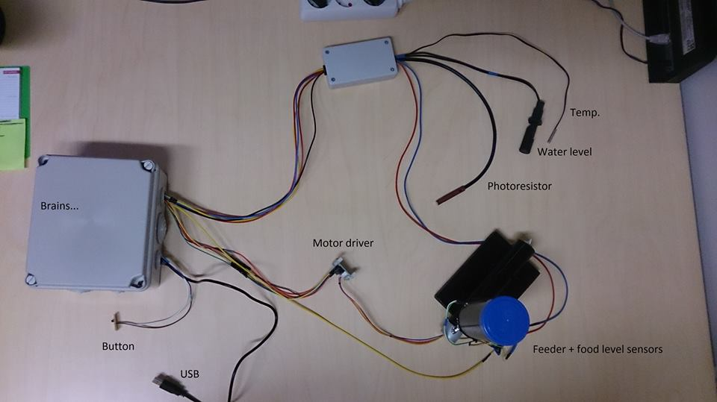
Final result

Slide 11
Project Organisation
Building feeder system-Kätlin/Sander
Attaching feeding system
Implementing level sensor
Building feedtank
Programming motor
Implementing and programming lighting sensor- Sander
Implementing and programming temperature sensor- Aivar
Implementing and programming water level sensor- Martin
Implementing and programming feed level sensor- Sander
Integrating the codes in one- Marek/Aivar
Establis connection between MSP430- Marek/ Aivar
Establis connection to main server- Marek/Aivar

Slide 12
Working Plan
S6 – hardware ordering
S7 – working out the system architecture
S8 – S14 – programming and building the device
S15 – working solution
S16 – final project presentation

Slide 13
Cost calculation
Stepper motor+driver (Bought by team)
Feeder level sensor (Bought by team)
Aquarium (Provided by course)
Light sensor (Bought by team)
Temperature sensor (10 €)
Water level sensor (Provided by course)
TI launchpad (Provided by course)
Radio module (Provided by course)
Auger and casing materials (Bought by team)
Power supply 12V (Provided by course)
FINAL COST 10 €

Slide 14
Thank you!

